Slide 1
ME751 Advanced Computational Multibody Dynamics
Section 9.4
February 23, 2010
“When You Come to a Fork in the Road, Take It!"
Yogi Berra
© Dan Negrut, 2010 ME751, UW-Madison

Slide 2
Before we get started…
Last Time:
Geometric Constraints
Covered four Basic and one Intermediate GCon’s
Recall that more complex GCon’s are obtained by combining the four basic ones: DP1, DP2, D, CD
Today:
Finish Geometric Constraints
Talk about their partial derivatives
HW5 – due on Feb. 25
Posted online
Reading: Example 9.4.7

Slide 3
Intermediate GCon: ?1 [Perpendicular 1]

Slide 4
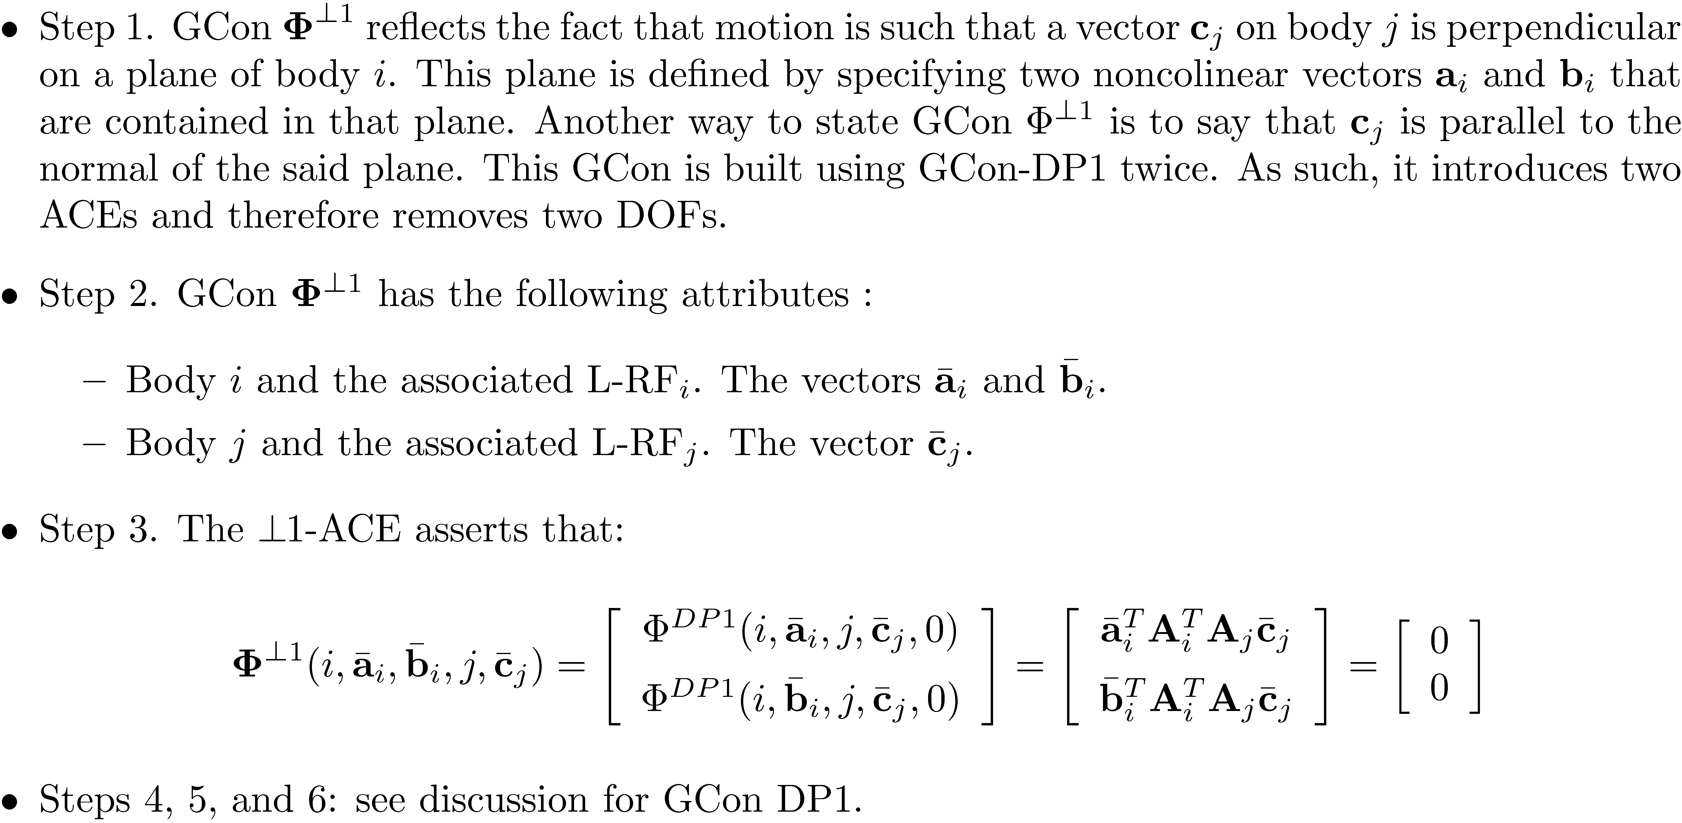
Intermediate GCon: ?1 [Cntd.]

Slide 5
Intermediate GCon: ?2 [Perpendicular 2]

Slide 6
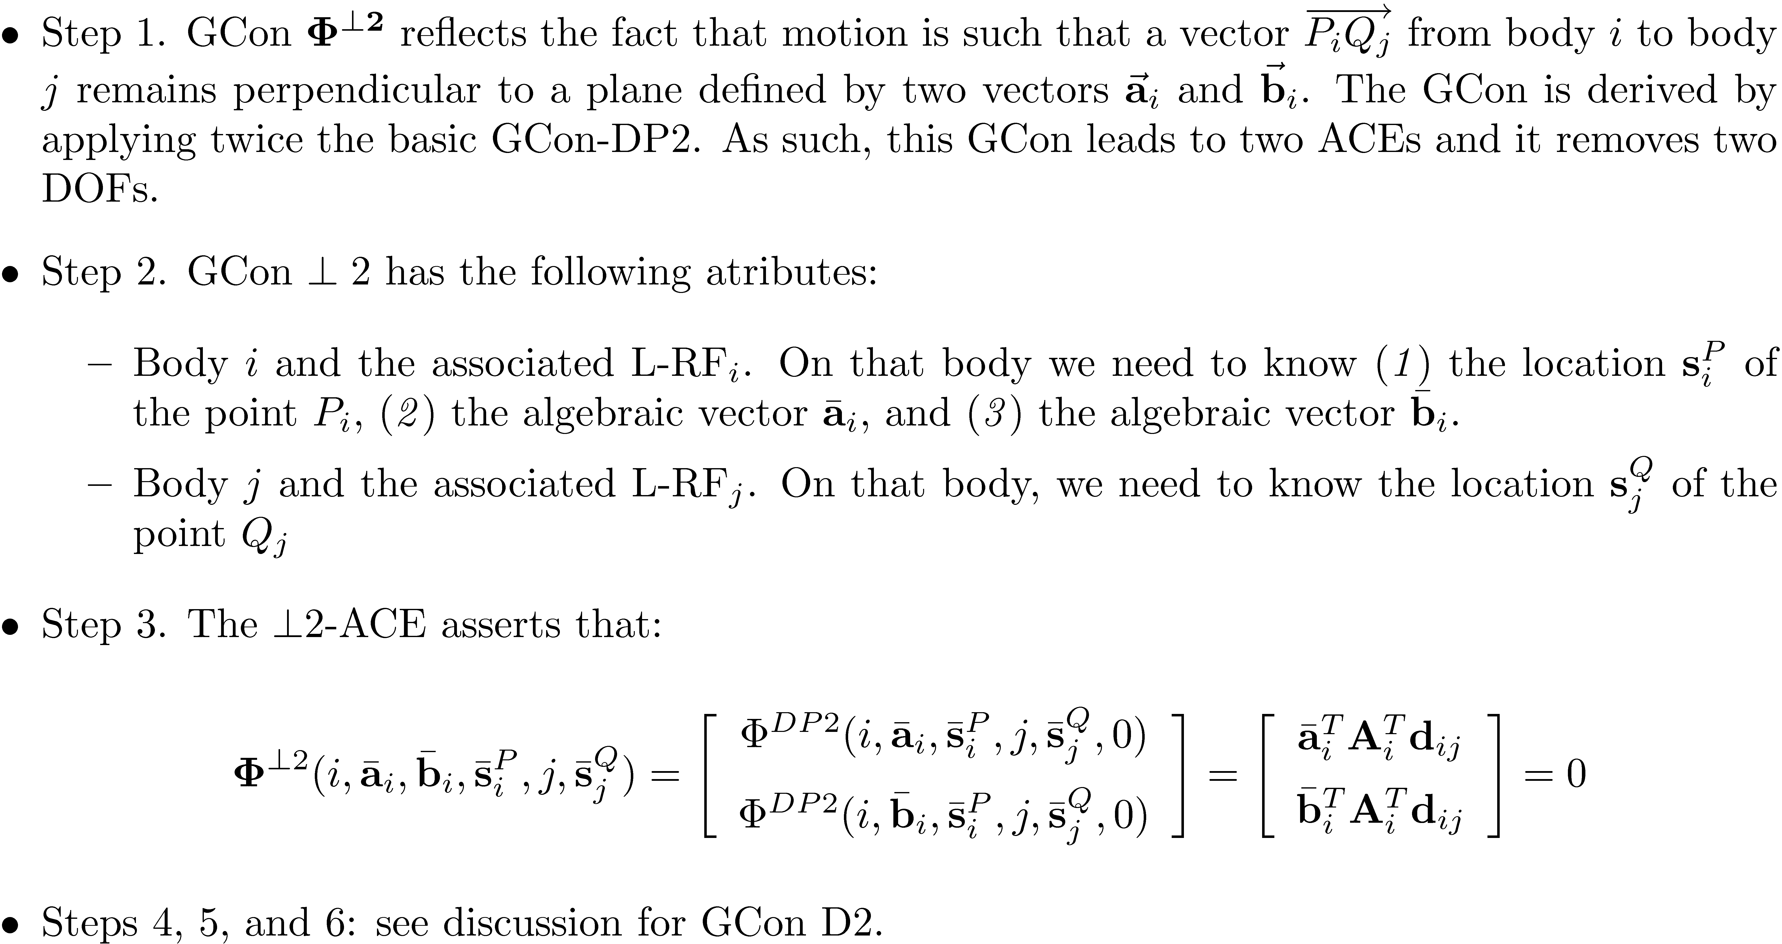
Intermediate GCon: ?2 [Perpendicular 2][Cntd.]

Slide 7
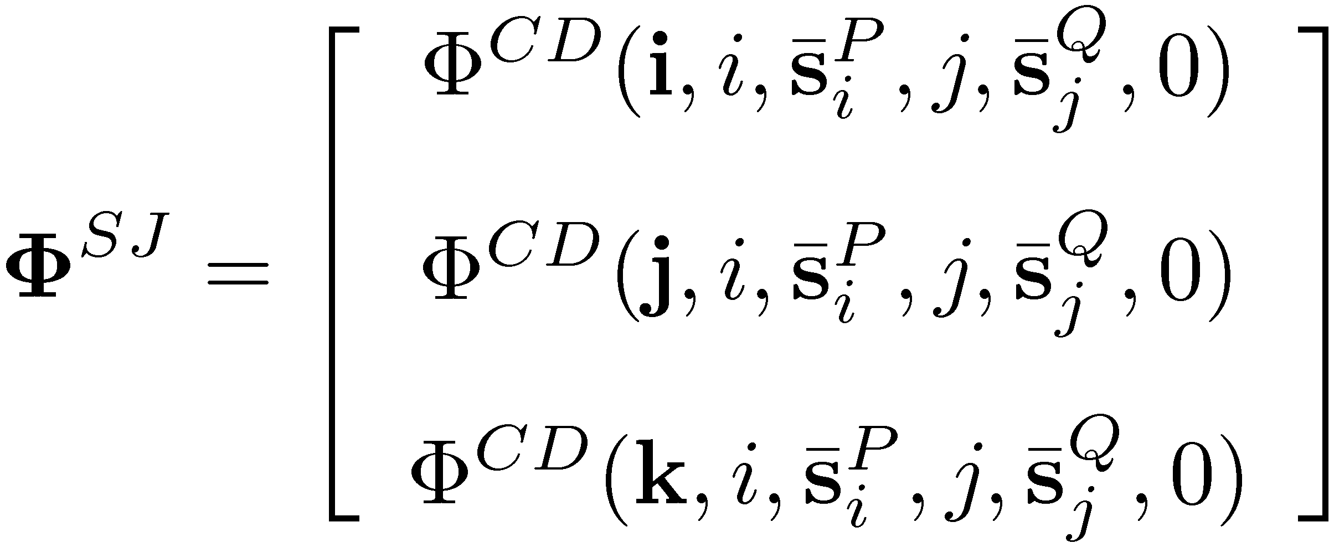
High Level GCon: SJ [Spherical Joint]

Slide 8
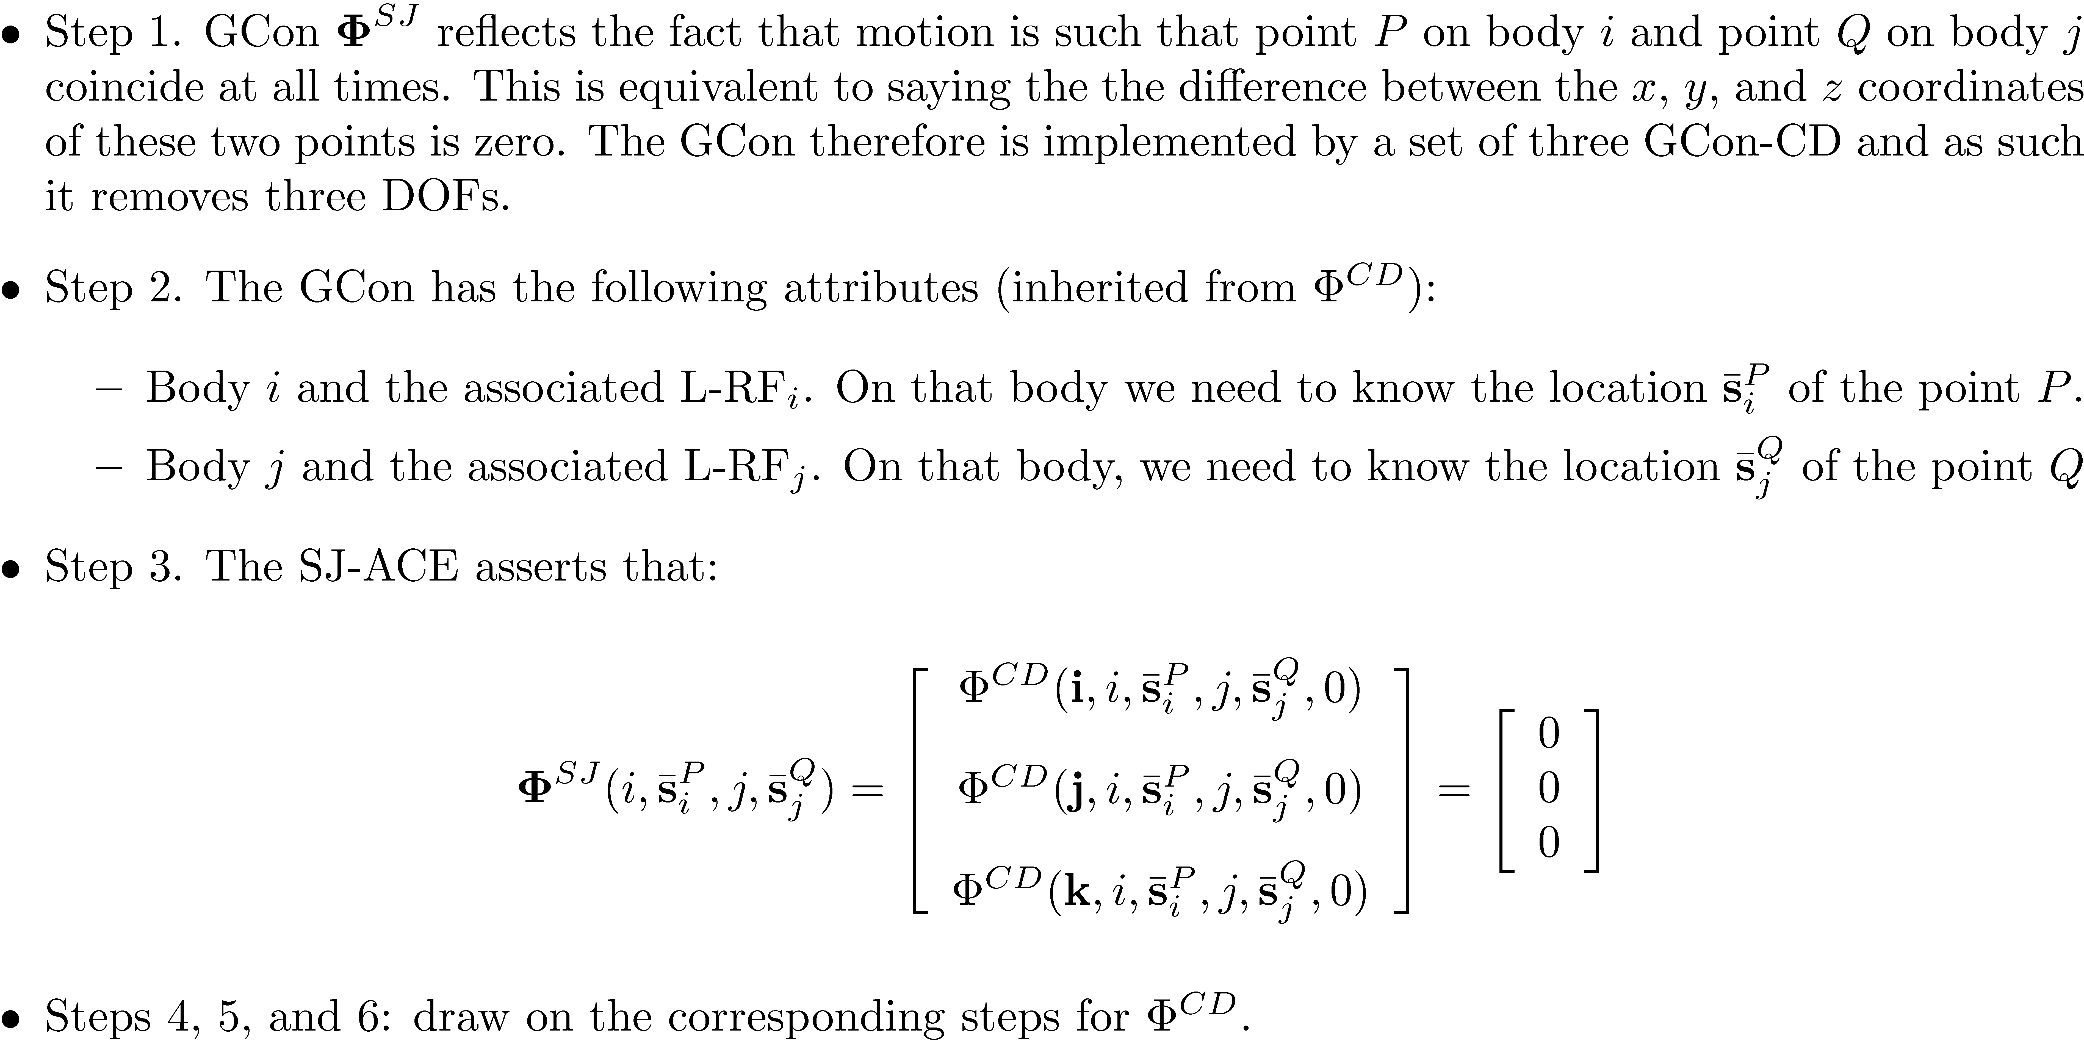
High Level GCon: Spherical Joint

Slide 9
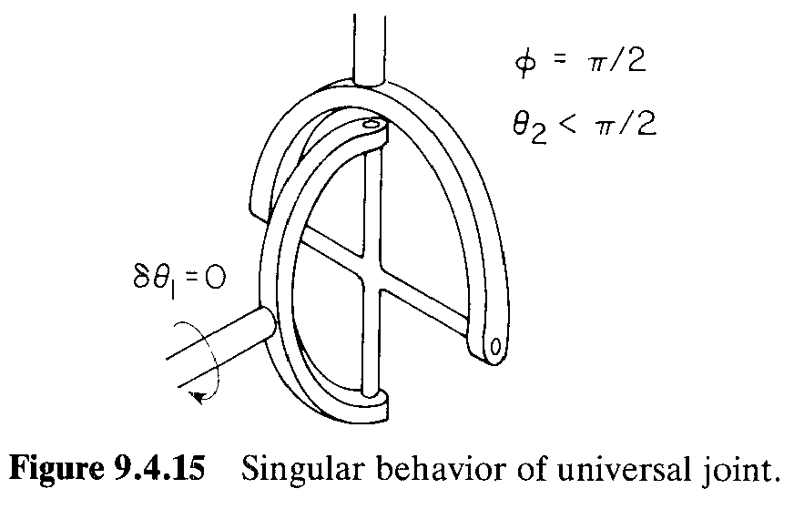
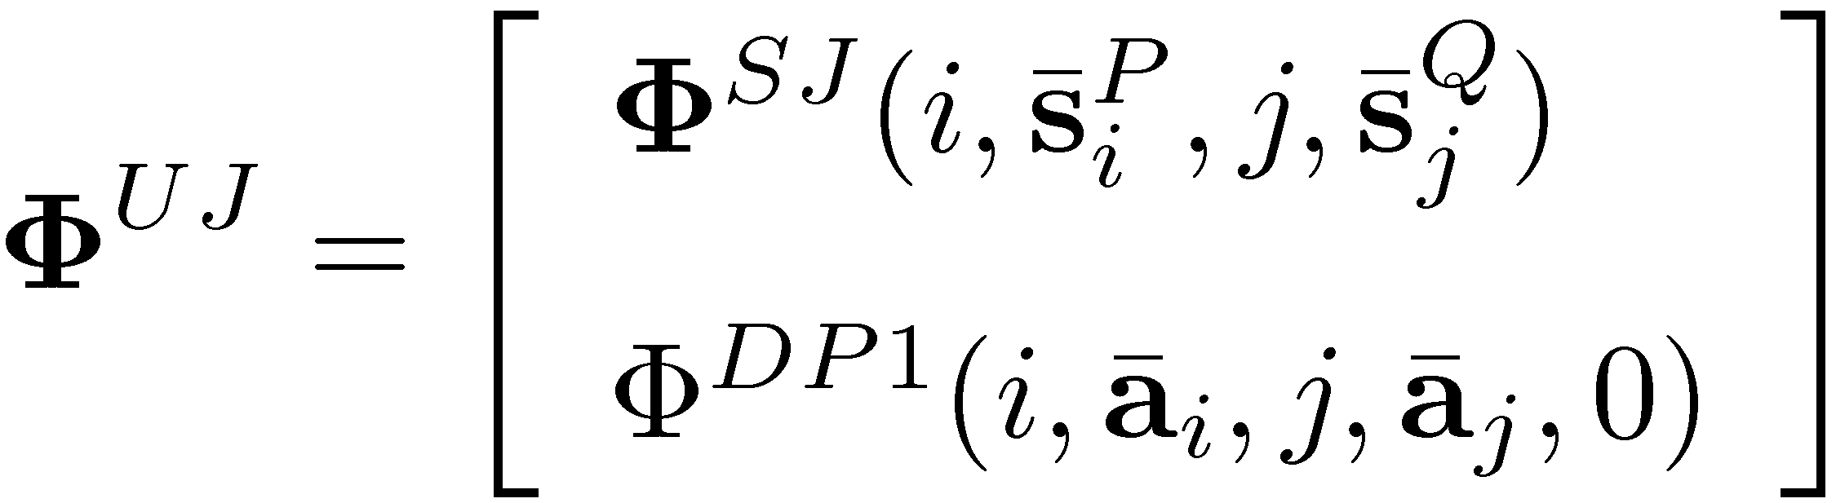
High Level GCon: UJ [Universal Joint]

Slide 10
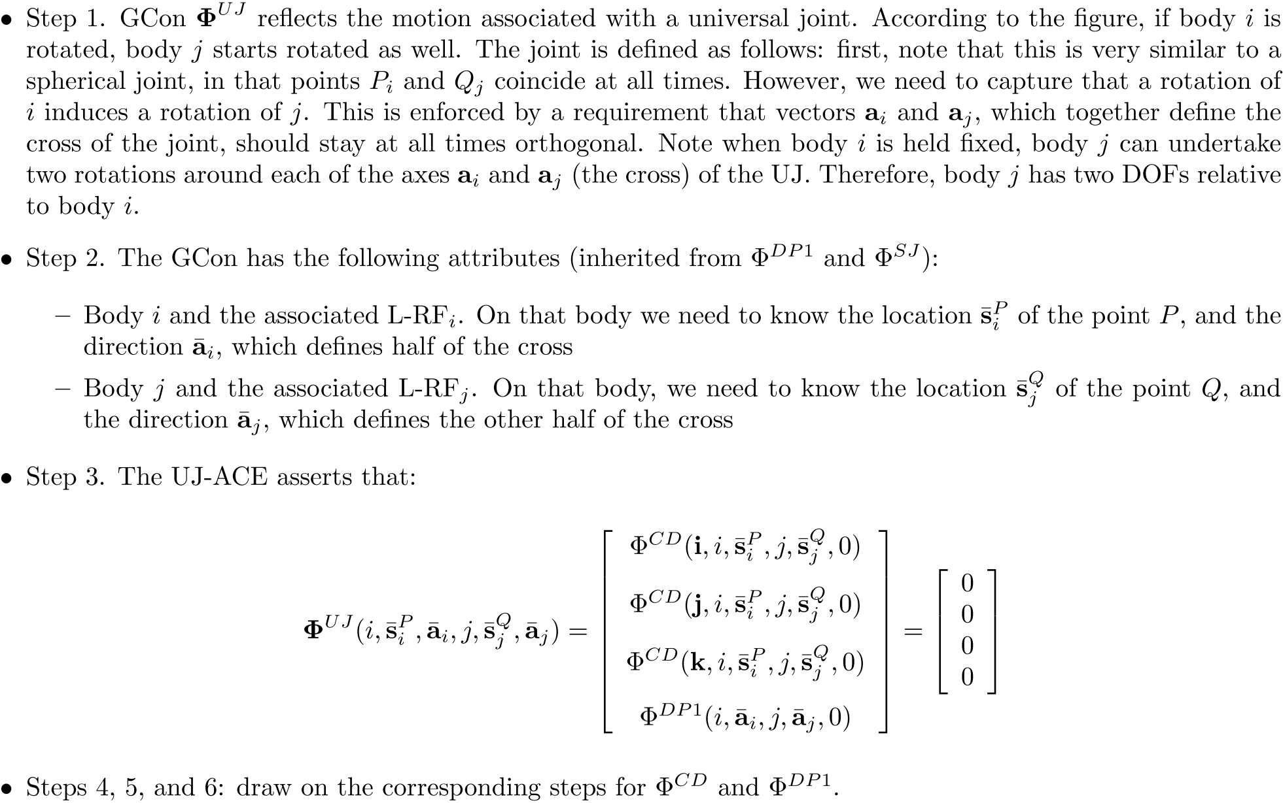
High Level GCon: UJ [Universal Joint]

Slide 11
High Level GCon: CJ [Cylindrical Joint]

Slide 12
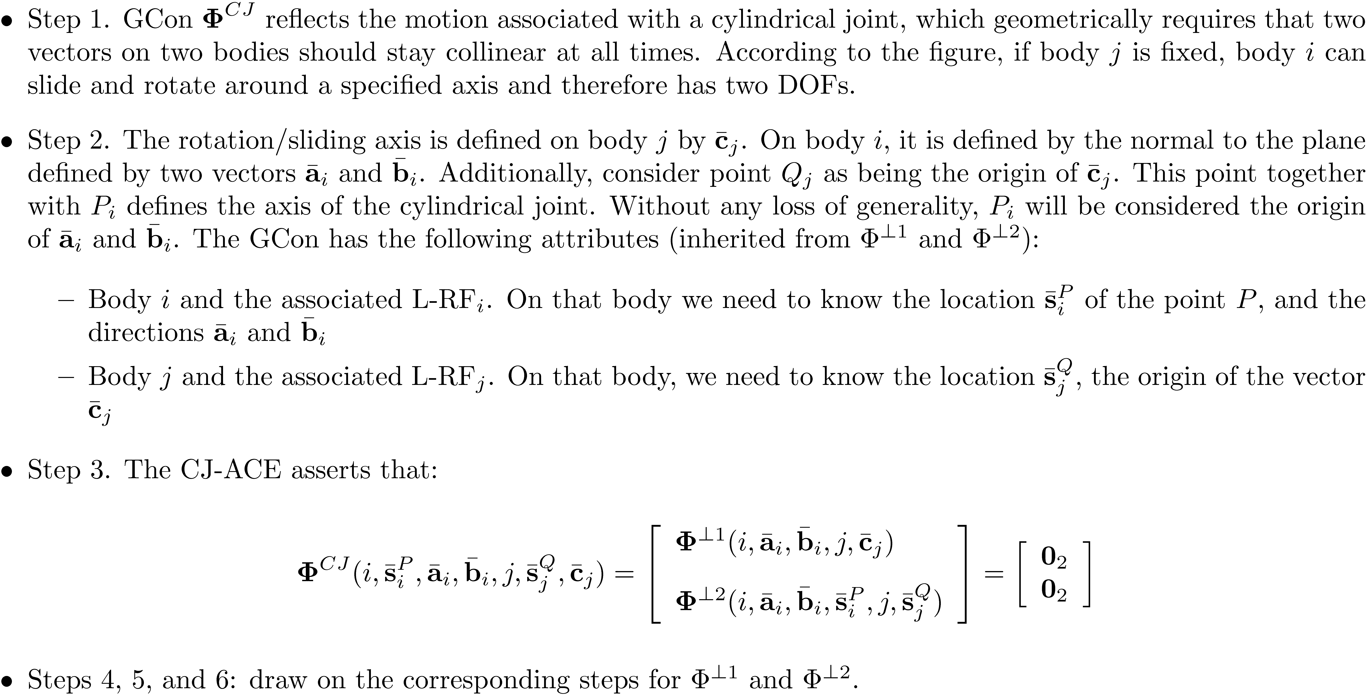
High Level GCon: CJ

Slide 13
High Level GCon: RJ [Revolute Joint]

Slide 14
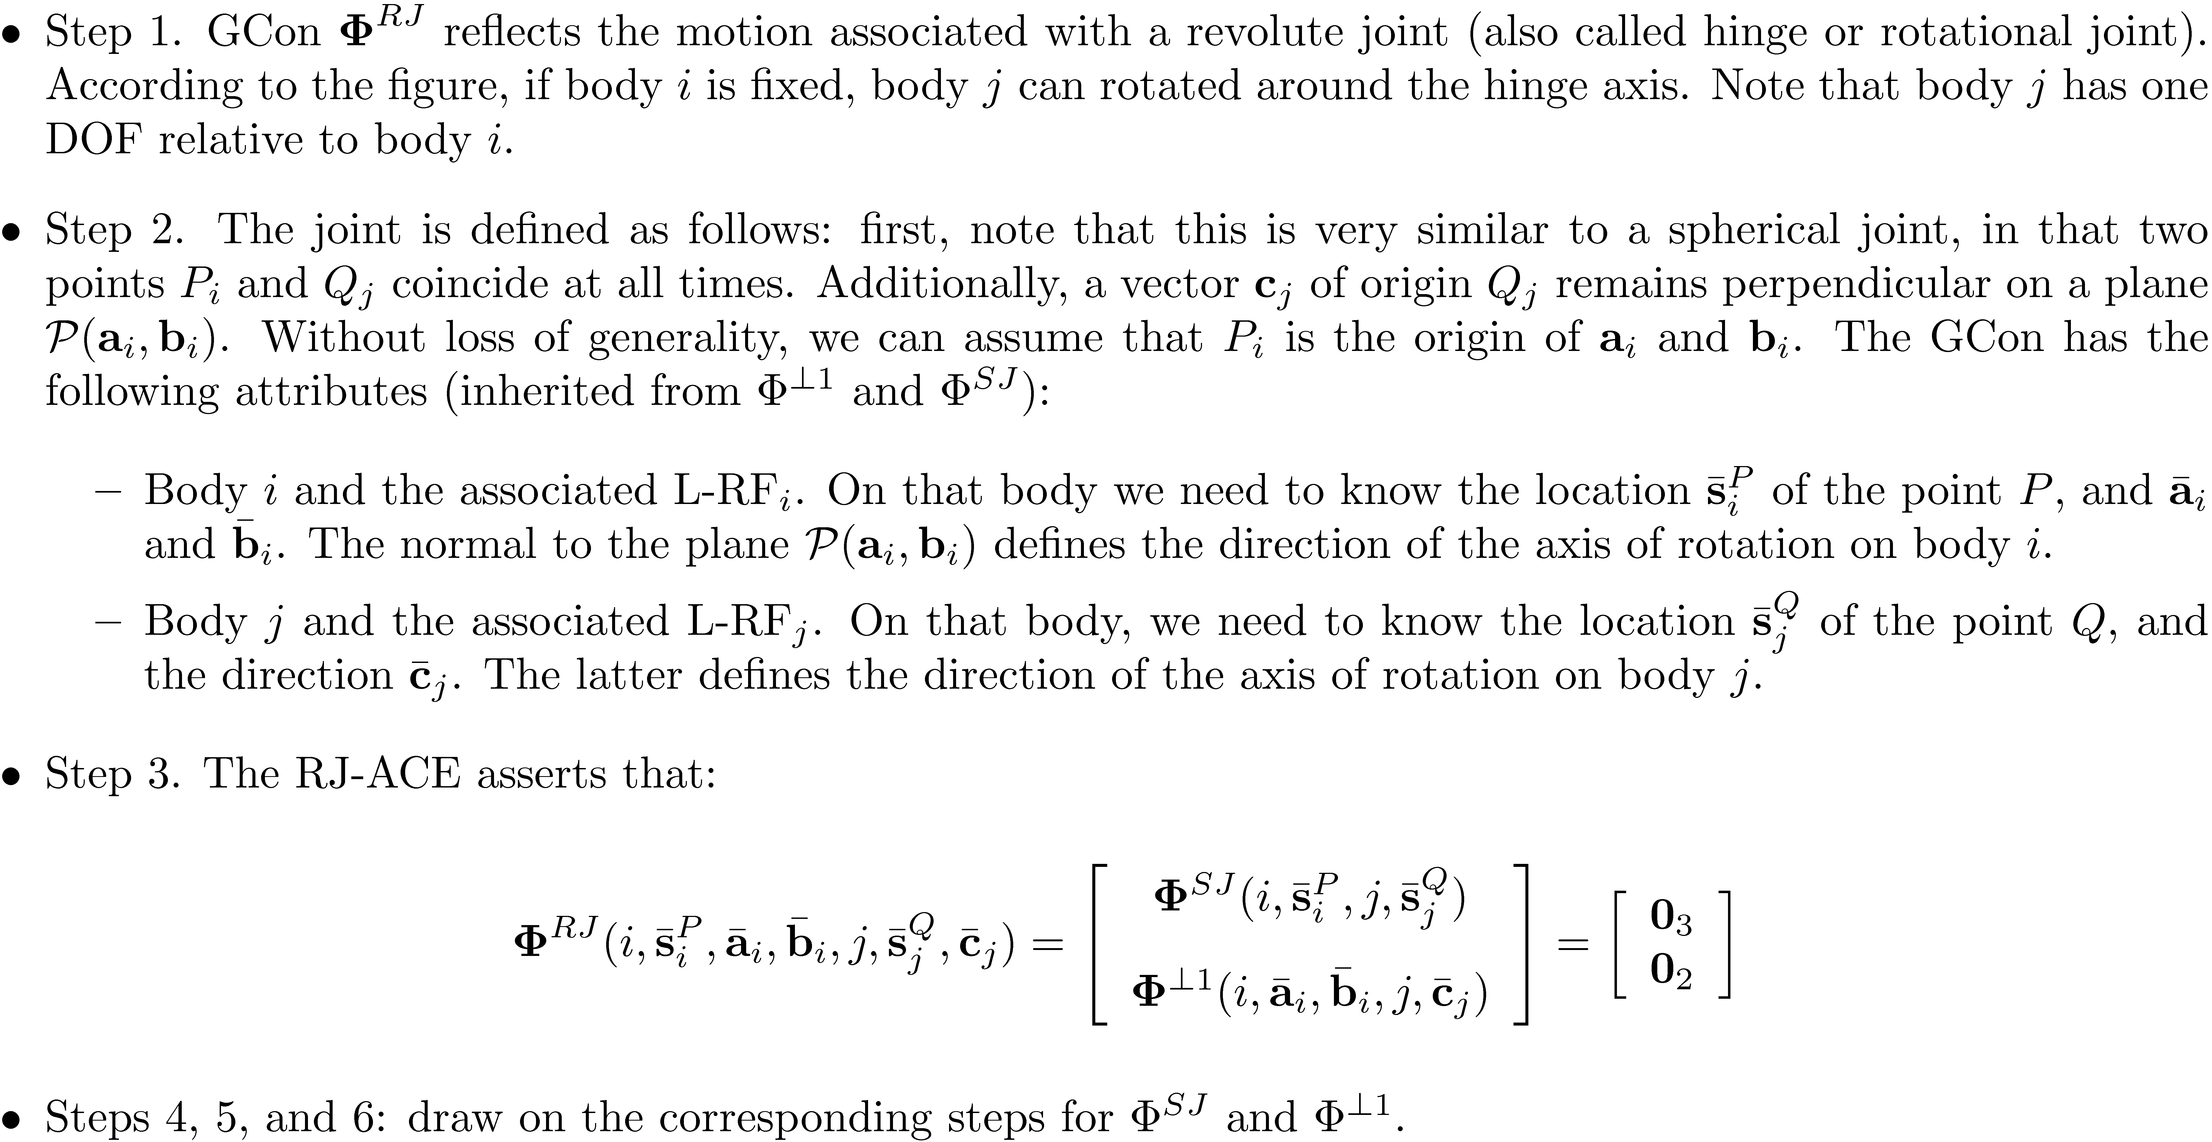
High Level GCon: RJ

Slide 15
High Level GCon: TJ [Translational Joint]

Slide 16
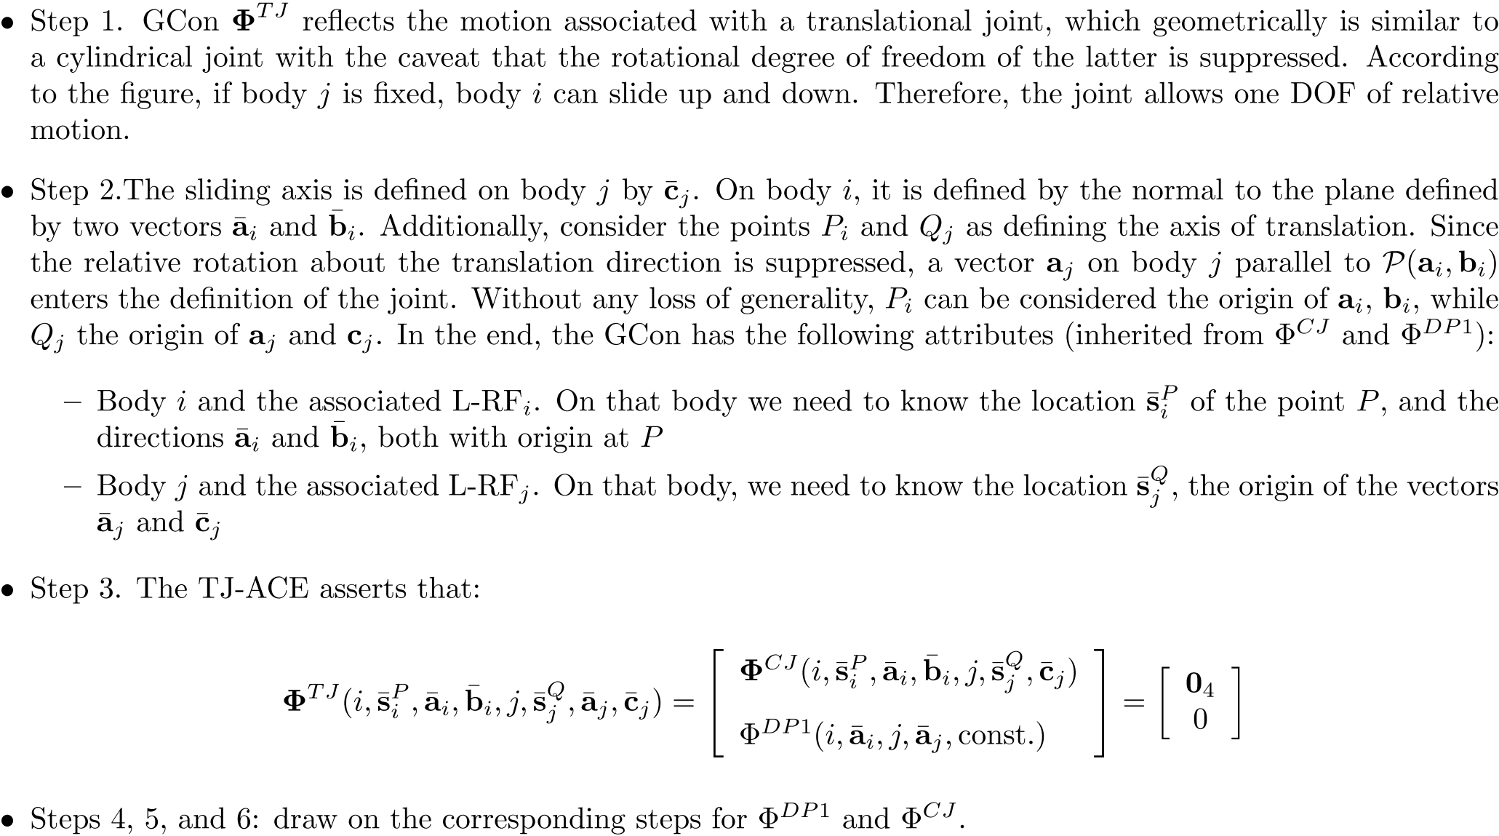
High Level GCon: TJ

Slide 17
GCon’s: Concluding Remarks
All the basic geometric constraints are scalar conditions
If you want to implement your own Kinematics solver, with only four basic constraints you can cover 80% of the most used GCons
The approach outlined for defining various GCons is not unique
Don’t have to use the four building blocks, you can have each GCon be defined in its own specific way
If you do this, you lose generality, hard to write software to generate a library of GCons
Unfinished business: We still have to produce the Jacobian matrices for the four basic geometric constraints

Slide 18
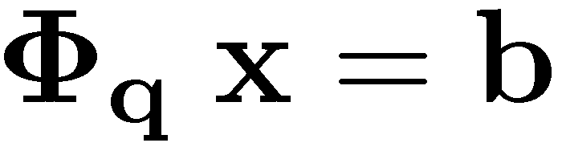
Kinematics Analysis: Comments on the Three Stages
The three stages of Kinematics Analysis: position analysis, velocity analysis, and acceleration analysis they each follow *very* similar recipes for finding for each body of the mechanism its position, velocity, and acceleration, respectively
ALL STAGES RELY ON THE CONCEPT OF JACOBIAN MATRIX:
Φ_{q} – the partial derivative of the constraints wrt the generalized coordinates
ALL STAGES REQUIRE THE SOLUTION OF A SYSTEM OF EQUATIONS
WHAT IS DIFFERENT BETWEEN THE THREE STAGES IS THE EXPRESSION OF THE RIGHT-SIDE OF THE LINEAR EQUATION, “b”

Slide 19

“When You Come to a Fork in the Road, Take It!"
Yogi Berra

Slide 20
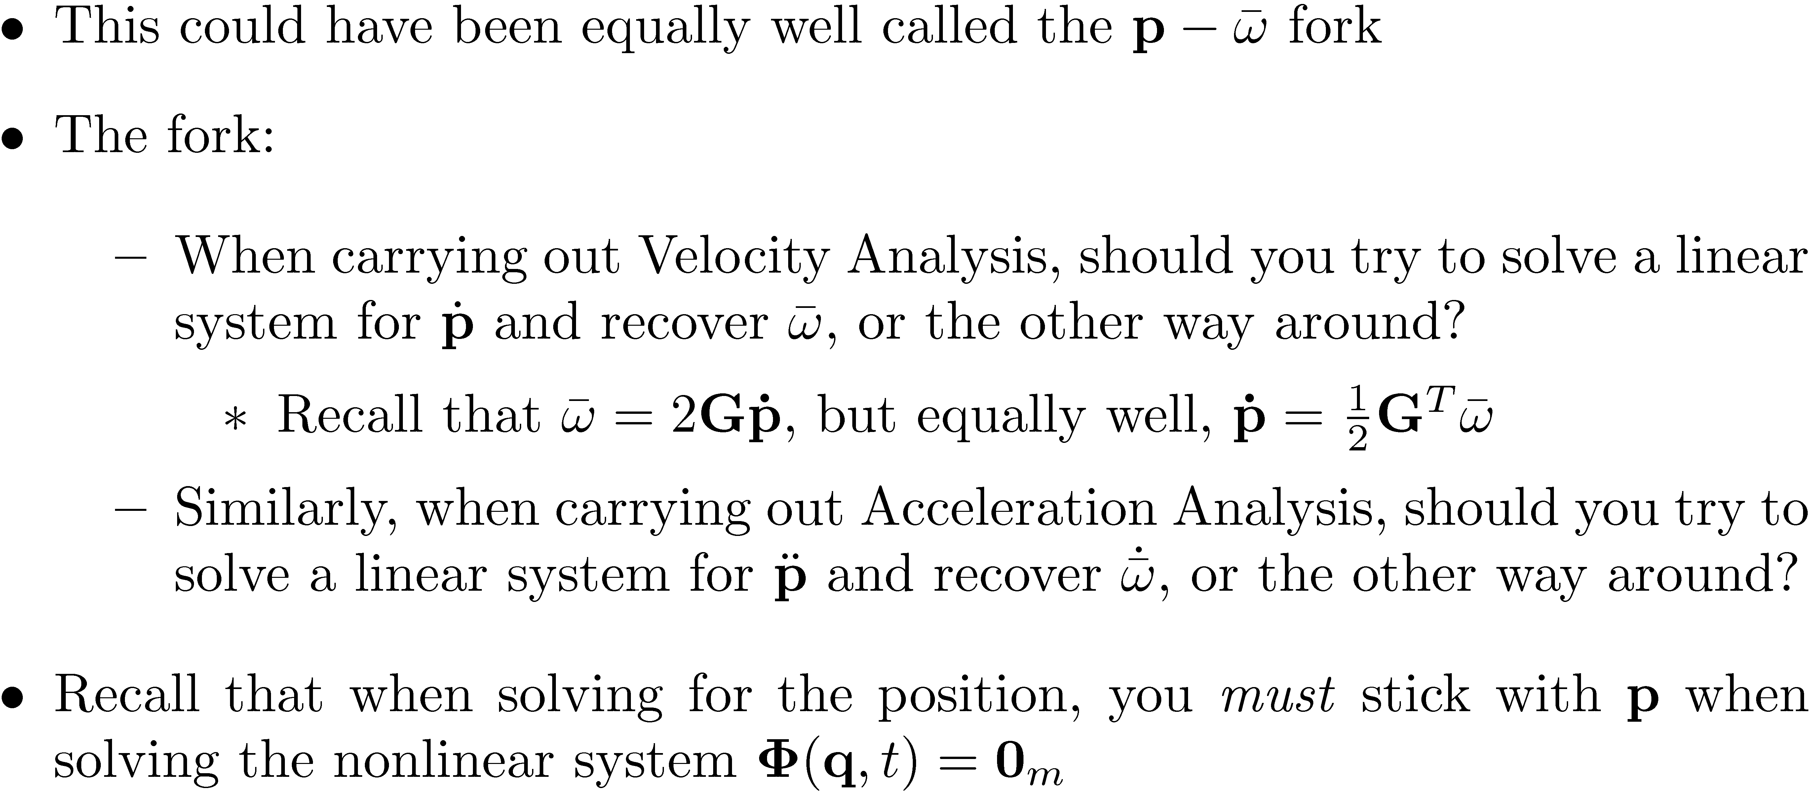

Slide 21
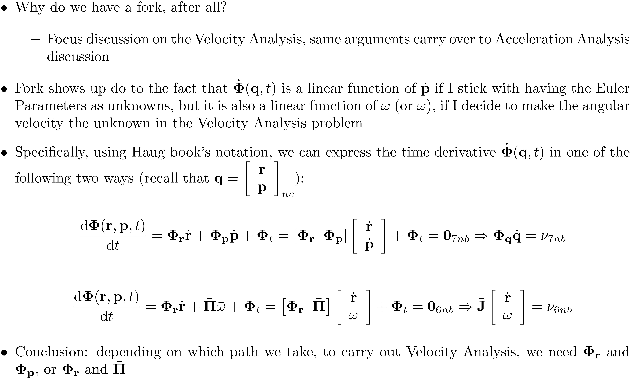
[Cntd.]

Slide 22
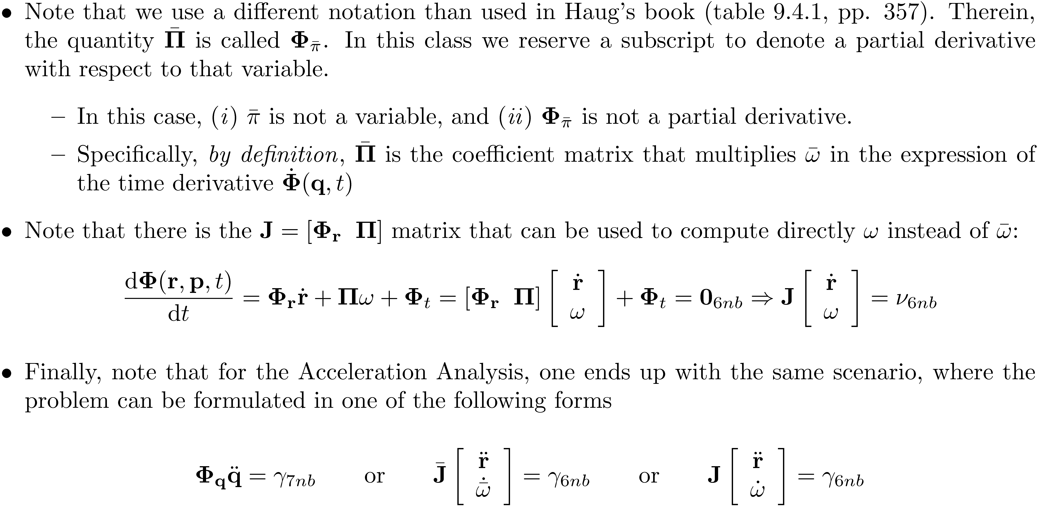
[Cntd.]

Slide 23

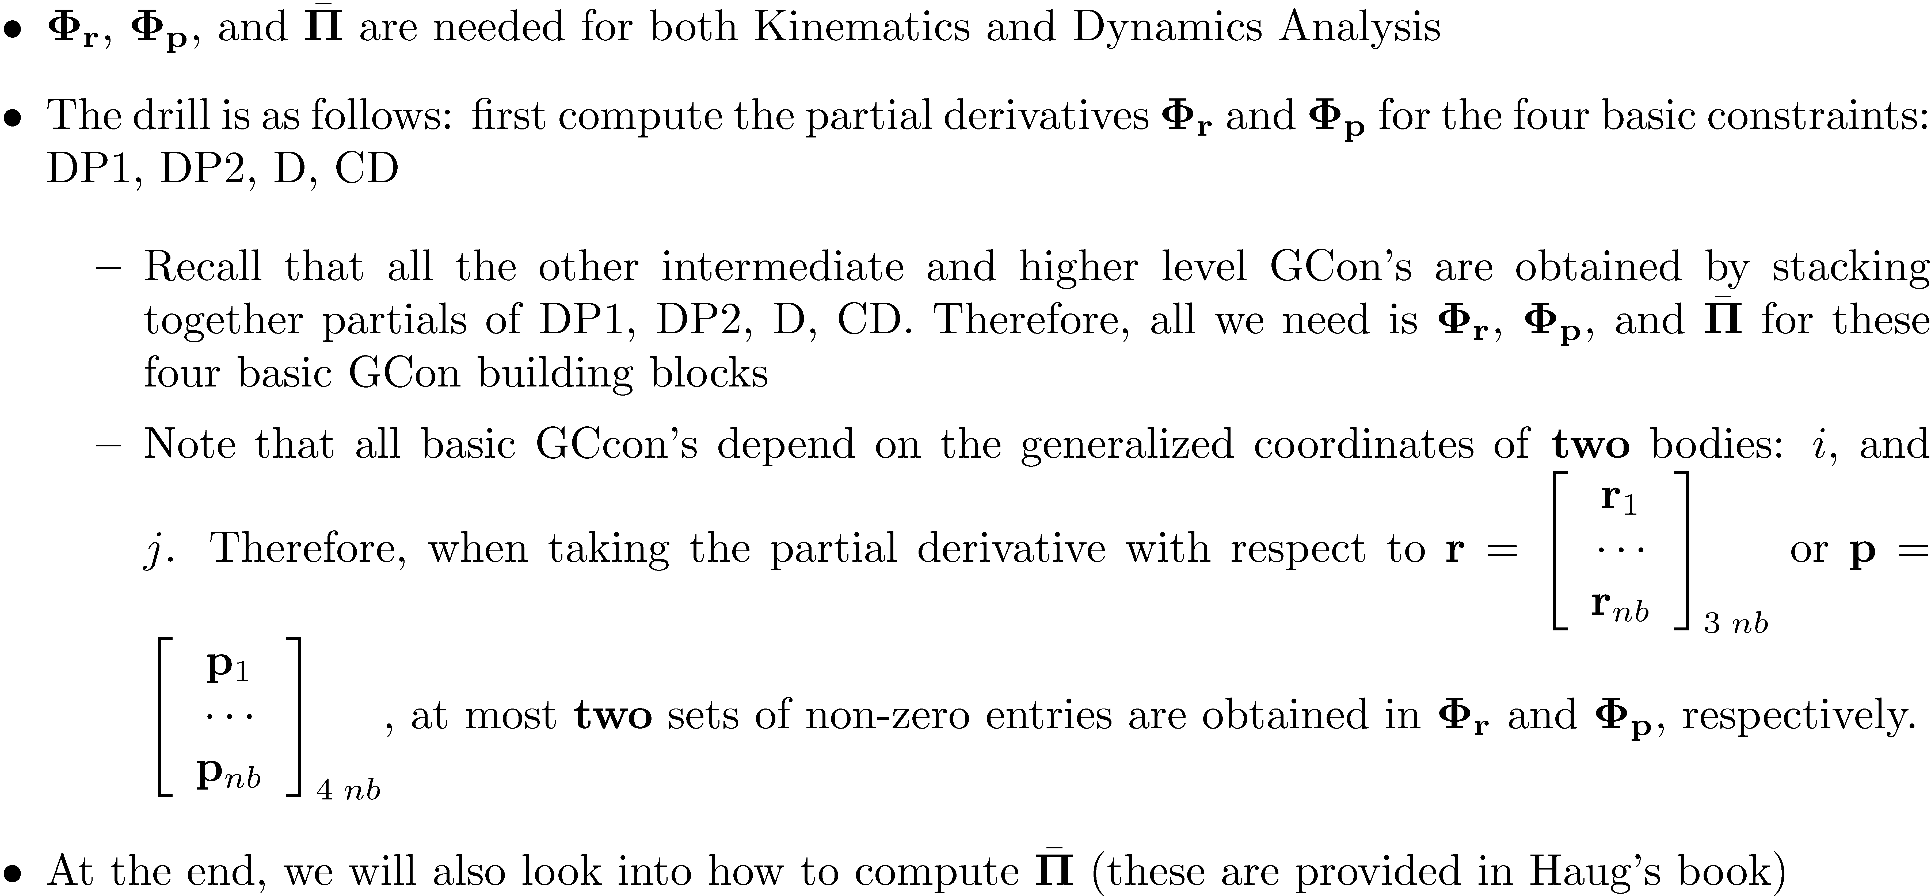

Slide 24

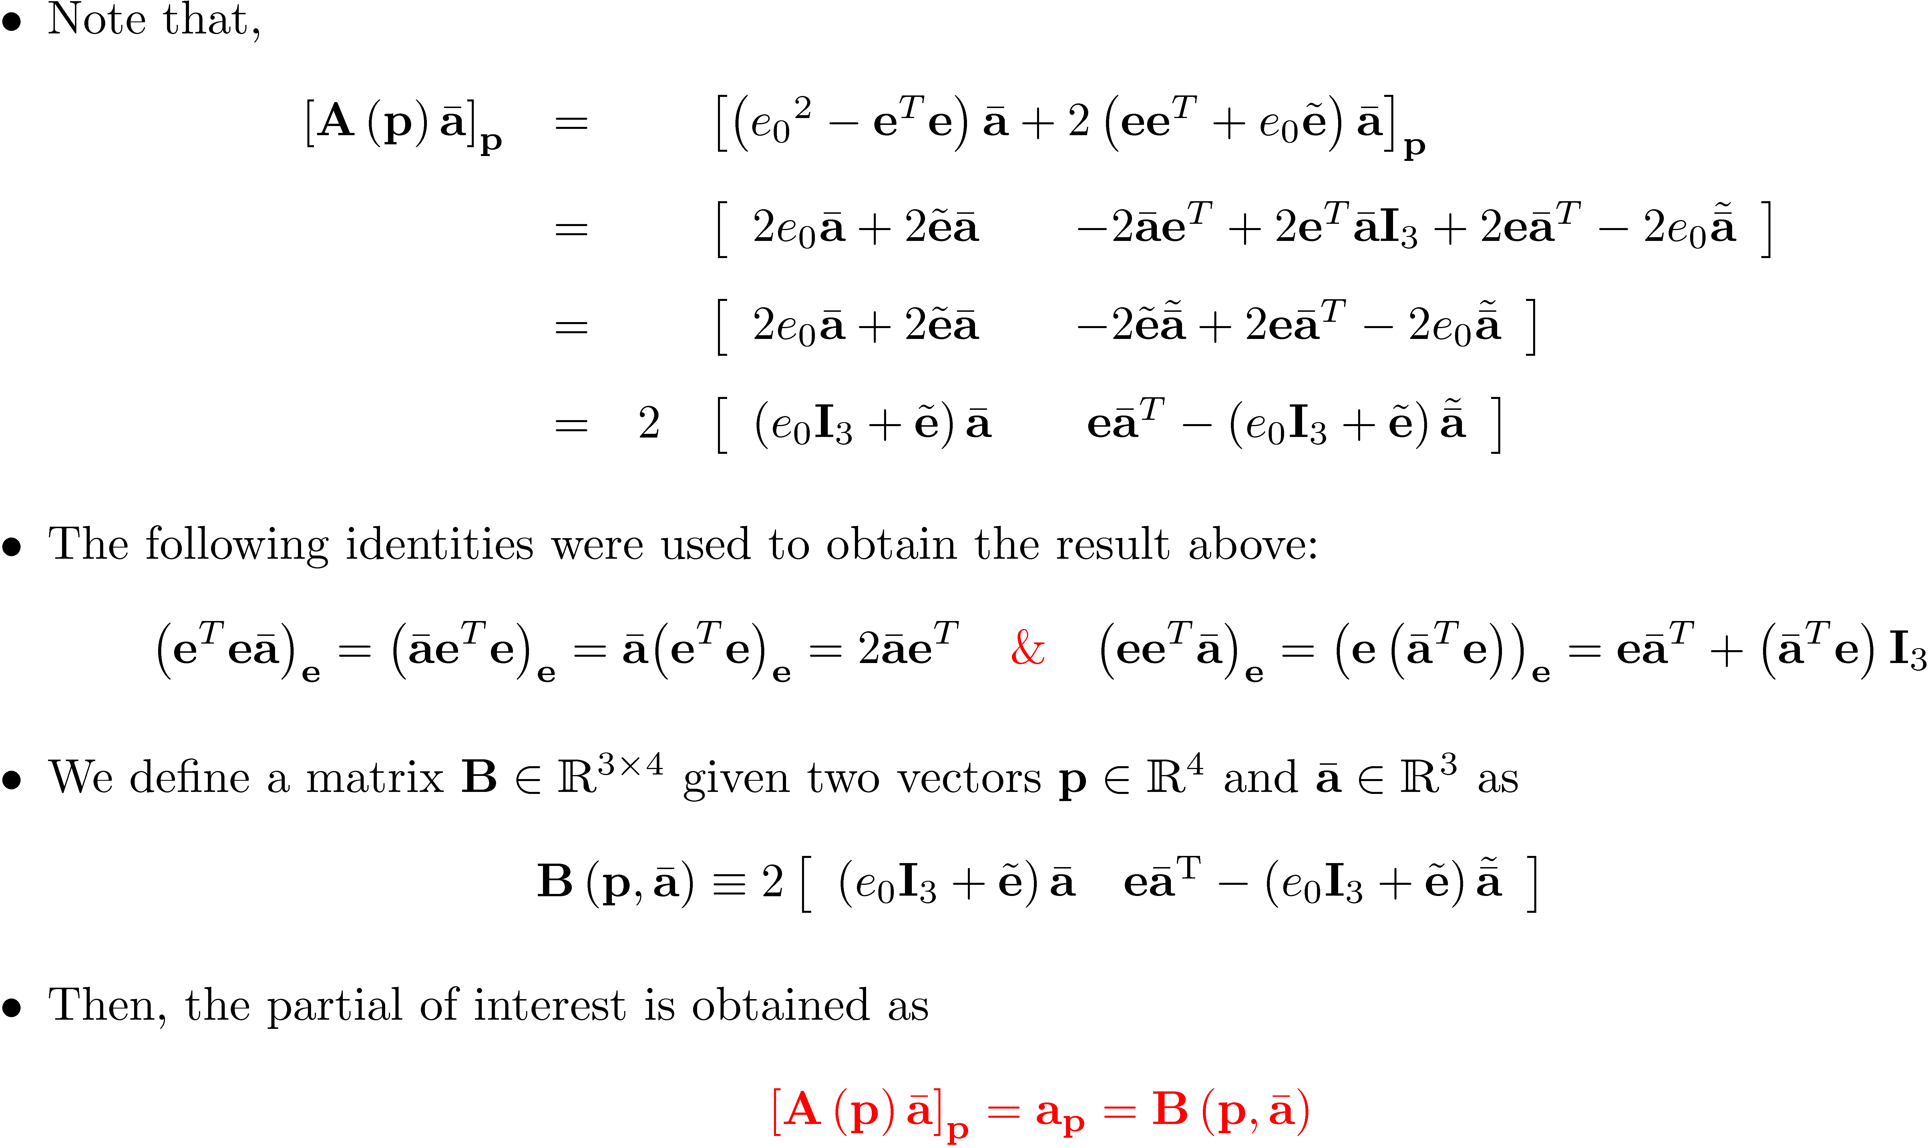
[Short Detour]

Slide 25
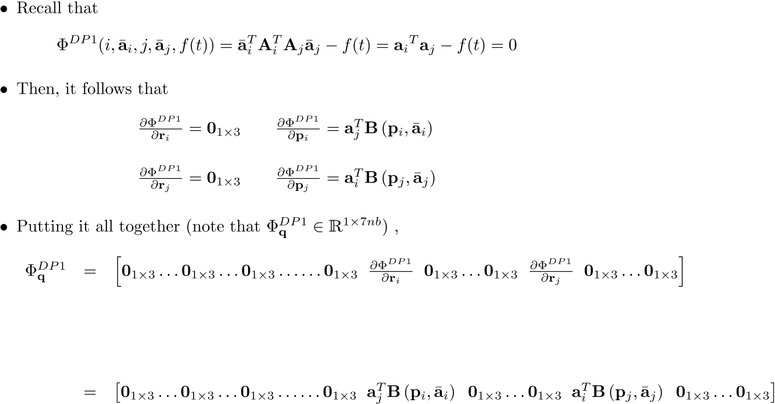
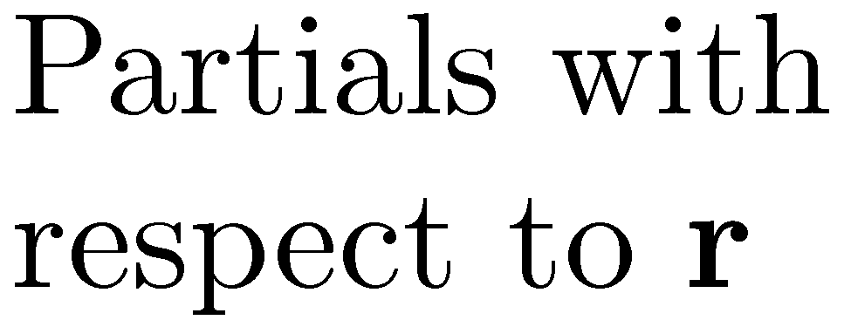
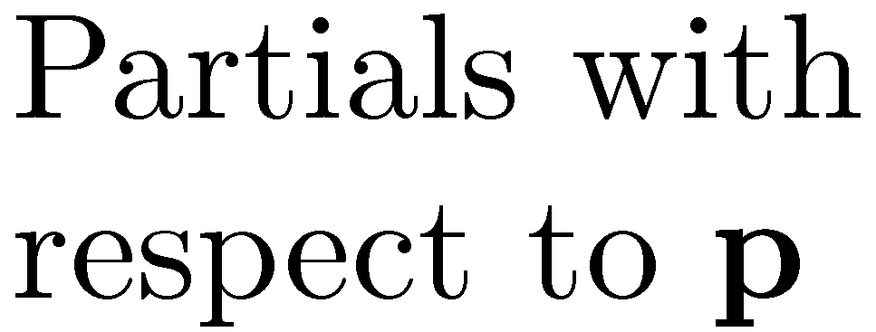
Body
1, r
Body
i, r
Body
j, r
Body
i-1, p
Body
i, p
Body
i+1, p
Body
j-1, p
Body
j, p
Body
j+1, p
Body
nb, p

Slide 26

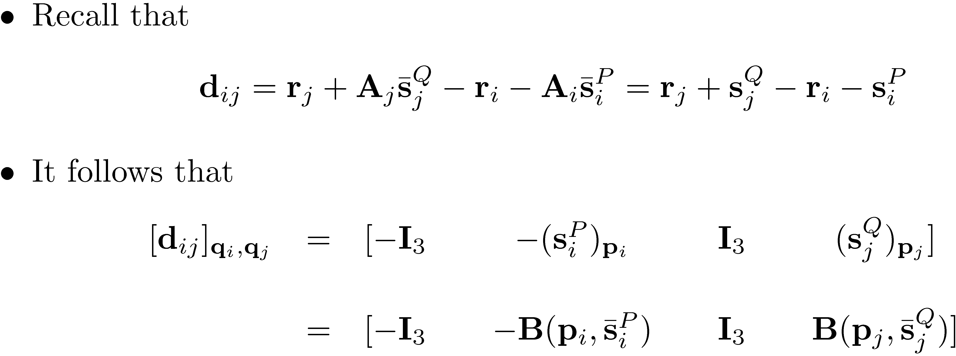
[Short Detour]:

Slide 27
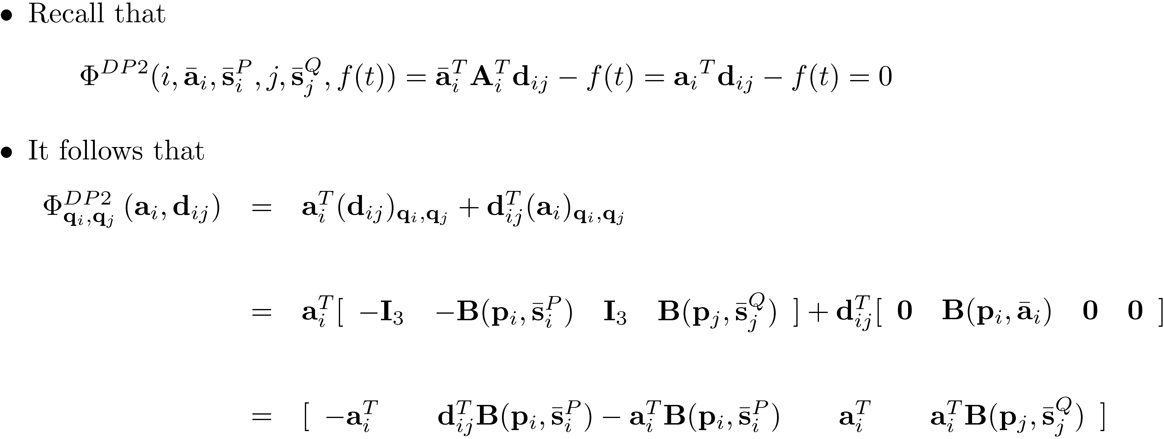

Slide 28
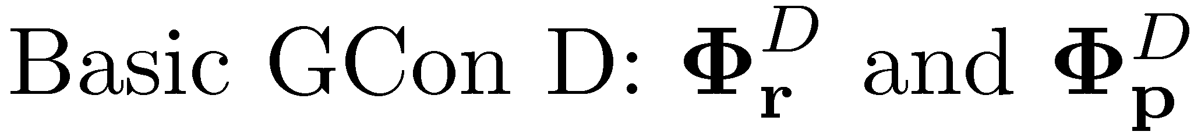
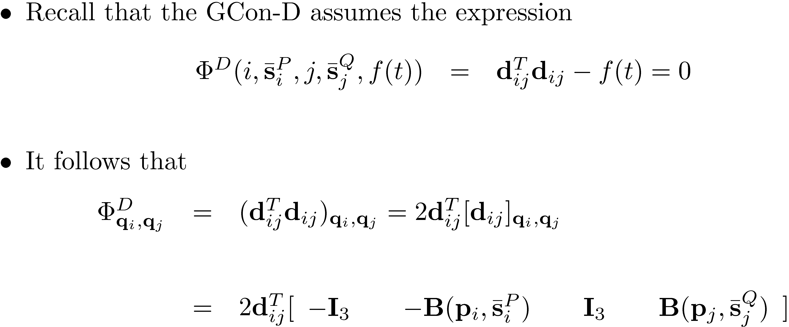

Slide 29
